Slide 1


Town of Plainville
& Plainville Community Schools
Budget Update
January 15, 2019
Robert E. Lee:
Town Manager
Dr. Maureen Brummett:
Superintendent of Schools
Notes:
Good Evening I am Maureen Brummett, Superintendent of Schools - I would like to thank Sam Adlerstein, Director of Business and Operations and Steve LePage, Assistant Superintendent and my entire Central Office team for their support and assistance in putting tonight’s presentation together. I appreciate the collaborative approach with the Board and Town that has been behind tonight’s presentation. Robert Lee and I will go back and forth throughout the evening
https://3.basecamp.com/3539101/buckets/1523263/google_documents/345681777

Slide 2
Tonight’s Agenda
Historical Perspective
Demographics
BOE Current Budget Status
State Funding Impact
Vision in Action
Town Current Budget Status
Budget Schedule 2019-2020
Questions?
Notes:
Our agenda will include

Slide 3
Historical Perspective
Notes:
Good Evening I am Maureen Brummett, Superintendent of Schools - I would like to thank Sam Adlerstein, Director of Business and Operations and Steve LePage, Assistant Superintendent and my entire Central Office team for their support and assistance in putting tonight’s presentation together. I appreciate the collaborative approach with the Board and Town that has been behind tonight’s presentation. Robert Lee and I will go back and forth throughout the evening
https://3.basecamp.com/3539101/buckets/1523263/google_documents/345681777

Slide 4
Expenditures

Slide 5
Expenditures – 10 Year Change
FY 2009 - $52,694,589
FY 2019 - $60,056,058
Difference - $7,361,469
            14% over ten years
            1.4% per year average

Slide 6
Expenditures: Four Major Categories
Town
Board of Education
Debt Service
Capital Projects

Slide 7
Town Expenditures
FY 2009 - $14,520,653
FY 2019 - $17,533,146
Difference - $3,012,493
            20.75% over ten years
            2.08% per year average

Slide 8
Board of Education Expenditures
FY 2009 - $32,271,879
FY 2019 - $37,322,912
Difference - $5,051,033
            15.65% over ten years
            1.57% per year average

Slide 9
Debt Service Expenditures
FY 2009 - $4,802,057
FY 2019 - $4,400,000
Difference - ($402,057)
            (8.4%) over ten years
            (.84%) per year average
FY 2019 decrease ($312,294)

Slide 10
Capital Improvement Expenditures
FY 2009 - $1,100,000
FY 2019 - $800,000
Difference - ($300,000)
            (27%) over ten years
            (2.7%) per year average
      This current amount ($800,000) is not addressing the needs in the Capital Improvement Budget.
Note:

Slide 11
Expenditures
How Does the Total Budget Increase Compare?
Previous 10 years (FY 1999 to 2009)
Inflation Rate (FY 2008 to 2017)
Social Security Increase (FY 2008 to 2017)

Slide 12
Previous Ten Years
 | 1999-2009 | 2009-2017
Total Budget Increase | $16,882,857.00 | $7,361,468.00
Total Budget % Increase | 47.14% | 13.97%
Average Yearly Increase | 4.7% | 1.4%
Budget increase reduced over a ten year period by $9,521,388.
Budget increase reduced over a ten year period by 56%.
Average yearly increase reduced from 4.7% to 1.4%.

Slide 13
Inflation Comparison
The inflation rate has increased by 16% over the last ten years (2008 to 2017).
If one paid $1.00 for an item in 2008, it would now cost $1.16 as a result of inflation.
    Total Town Budget
    Increase from FY 2009 – 2019 14% (Avg. 1.4% per year)
    Inflation Rate 16% (Avg. 1.6% per year)
Total Budget increase has been 12.5% less than the rate of inflation over the last ten years. (2% ÷16%).
Taking inflation into account, the expenditure budget has actually decreased over the last ten years.
The inflation rate for 2018 was 2.13%.

Slide 14
Social Security Increases
Social Security increased 17.72% over the last ten years (2008-2017).
    Total Town Budget
    Increase from FY 2009 – 2019 14% (Avg. 1.4% per year)
    Total Social Security Increase (2008-2017) 17.72% (Avg. 1.77% per year)
The Total Budget increase has been 21% LESS than the Social Security Increase over the last ten years (3.72% ÷ 17.72%).
Social Security increase is 2.8% beginning January 2019.

Slide 15
Revenues

Slide 16
Revenues
FY 2009 - $52,694,589
FY 2019 - $60,056,058
Difference - $7,361,469
            14% over ten years
            1.4% per year average

Slide 17
Intergovernmental Revenues
FY 2009 - $12,399,616
FY 2019 - $11,233,458
Difference - ($1,166,158) or (9.4%)

Slide 18
All Other Revenues
FY 2009 - $3,634,035
FY 2019 - $1,783,143
Difference - ($1,850,892) or (51%)
All Other Revenues
 | FY 2009 | FY 2019 | Difference
License & Permits | $ 264,950 | $ 281,700 | $ 16,750.
Fines & Fees | $ 279,700 | $ 271,700 | $ (8,000)
Use of Money | $ 500,500 | $ 30,500 | $ (470,000)
Other Revenues | $ 1,138,885 | $ 695,243 | $ (443,642)
Debt Management | $ 400,000 | $ 300,000 | $ (100,000)
Use of Fund Balance | $ 1,050,000 | $ 204,000 | $ (846,000)
 | $ 3,634,035 | $ 1,783,143 | $ (1,850,892)

Slide 19
Revenues
Over the last ten years both Intergovernmental and Other Revenues have declined by $3,017,050.

Slide 20
Property Tax Revenues
FY 2009 - $36,660,938
FY 2019 - $47,039,457
Difference - $10,378,519 or 28%
Overall Revenue Increase $7,361,469
Property Tax Increase $10,378,519
Difference $3,017,050
Difference in loss of Revenue from other sources

Slide 21
Summary of Revenues: 10 Year Trend
Summary of Revenue: 10 Year Trend
Intergovernmental Revenues - ($1,166,158)
All Other Revenues - ($1,850,892)
Property Taxes - $10,378,519
Total - $7,361,469
% of Total
 | FY 2009 | FY 2019
Property Taxes | 69.60 % | 78.30 %
Intergovernmental | 23.50 % | 18.70 %
All Other Revenues | 6.90 % | 3.00 %
 | 100.00 % | 100.00 %

Slide 22
Demographics
Notes:
Good Evening I am Maureen Brummett, Superintendent of Schools - I would like to thank Sam Adlerstein, Director of Business and Operations and Steve LePage, Assistant Superintendent and my entire Central Office team for their support and assistance in putting tonight’s presentation together. I appreciate the collaborative approach with the Board and Town that has been behind tonight’s presentation. Robert Lee and I will go back and forth throughout the evening
https://3.basecamp.com/3539101/buckets/1523263/google_documents/345681777

Slide 23
Plainville Population
CT Dept. of Health
  July 1, 2000
  17,327
  July 1, 2007
  17,193
  (0.8%)
  July 1, 2017
  17,705
  3.0%
  Plainville population has increased by 378 or 2.2% since the year 2000.
Notes:
Robert

Slide 24
Plainville Unemployment Rate
  Nov. 2016
  4.2%
  Nov. 2017
  4.1%
  Nov. 2018
  2.6%
  State unemployment rate= 3.0% (Nov. 2018)
Notes:
Robert

Slide 25
Plainville Unemployment Rate
Employed & Unemployed
  Employed
  Unemployed
  Total
  Nov. 2016
  10,069
  446
  10,515
  Nov. 2017
  10,110
  419
  10,529
  Nov. 2018
  10,362
  277
  10,639
Notes:
Robert

Slide 26
Plainville Median Household Income
  2015
  $58,500
  2017
  $62,459
  Increase of $3,959 or 6.8% over two years.
  3.4% average per year.
Notes:
Robert

Slide 27
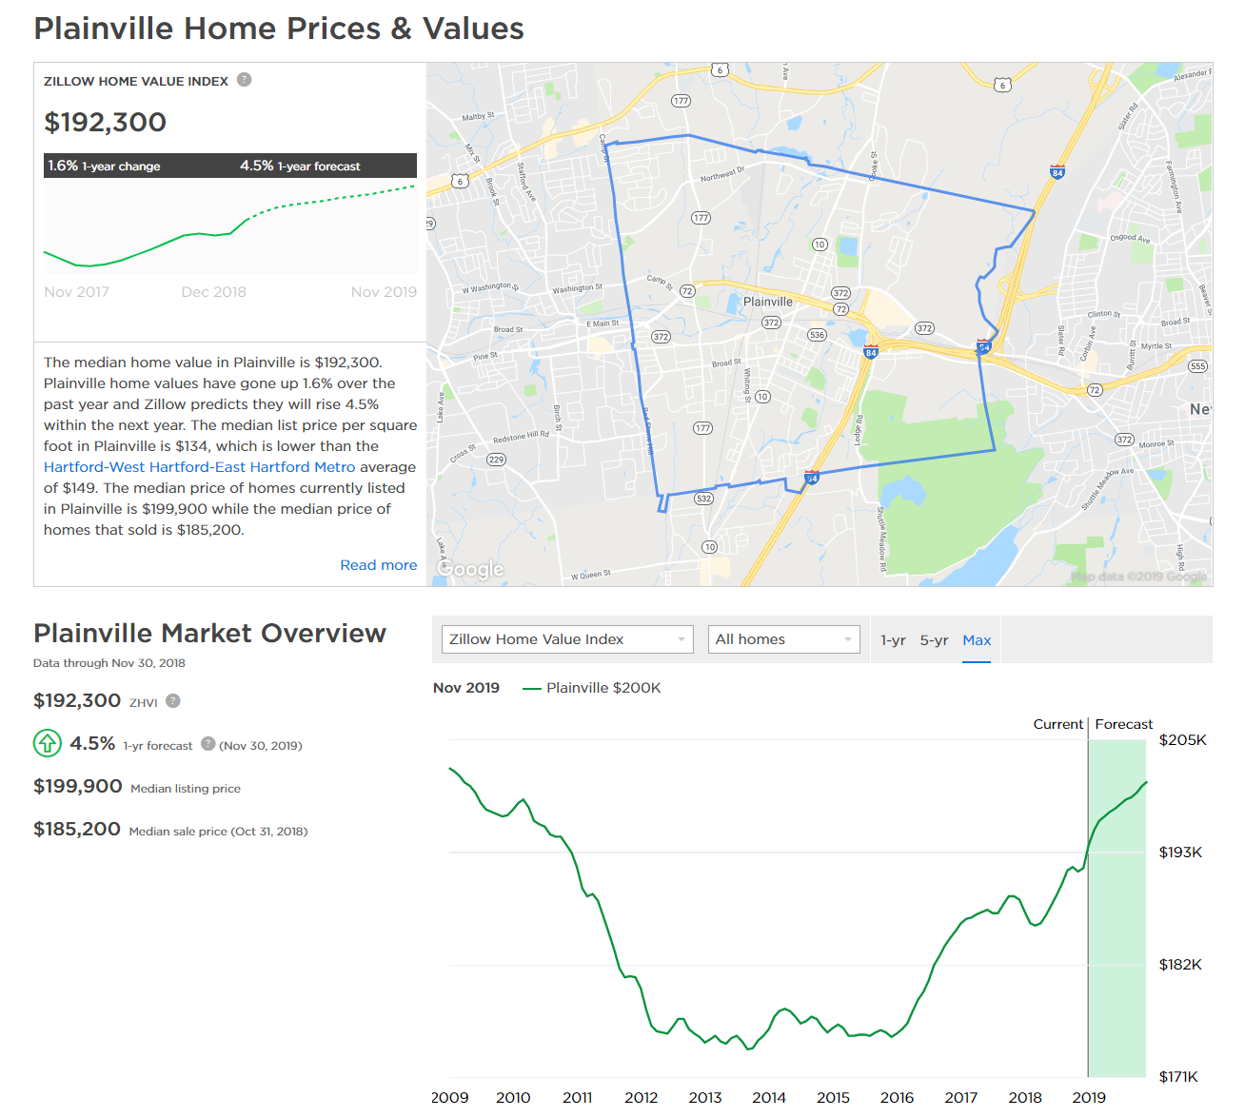
Notes:
https://www.zillow.com/plainville-ct/home-values/

Slide 28
State Funding Impact
Notes:
Good Evening I am Maureen Brummett, Superintendent of Schools - I would like to thank Sam Adlerstein, Director of Business and Operations and Steve LePage, Assistant Superintendent and my entire Central Office team for their support and assistance in putting tonight’s presentation together. I appreciate the collaborative approach with the Board and Town that has been behind tonight’s presentation. Robert Lee and I will go back and forth throughout the evening
https://3.basecamp.com/3539101/buckets/1523263/google_documents/345681777

Slide 29
VISION
To inspire and prepare lifelong learners to follow their passion, engage in their communities, and positively impact our global society
GOALS:
STUDENTS
TEACHING
LEARNING
Develop a student centered curriculum with an emphasis on the mastery of power standards and essential skills that ensure students are college and career ready upon graduation.
Provide teachers with regular collaboration time, relevant professional development, and meaningful feedback to promote innovative teaching practices.
Ensure that systems for assessing and measuring learning targets provide data to improve teaching practices and student learning.
ACTIONS:
-Embed global competencies
-Support positive school climate/PBIS
-Implement Capstone experience
-Enrich STEAM / Makerspace opportunities
-Maximize technology resources and
supports
-Continue Instructional Rounds
-Expand student access to curriculum through
multiple pathways
-Support the continuous improvement of
Professional Learning Communities
-Develop alternative programs
-Provide engaging digital resources
for learning
-Align curriculum to CT Core and
Next Gen. Science Standards
-Audit assessments to ensure they
inform instructional practices
OUTCOMES:
Expanded high quality preschool
Increased parent/family engagement
Enhanced community collaboration
Authentic, innovative, and creative curricular experiences
College and career proficiency
Flexible teacher evaluation plan
Professional development aligned to district vision and goals
Meaningful technology integration
Increased teacher collaboration time
Culturally responsive teaching practices
Teacher recognition for innovative practices
Learning targets aligned with college/career standards and global competencies
Teachers utilize assessment data to determine student learning needs in all curricular areas
Standards based grading practices
District wide curriculum writing academy is established
2017-2018
Notes:
Tonight I hope to convey that our well respected school system is at the heart Plainville’s vibrant, fiscally responsible community.
It is also important to note that this meeting is held a bit earlier in the budget process than last year. The Board will begin their budget development workshop on Monday, January 22 @7:00 in the PHS Learning Commons. Therefore today’s presentation will not have specific budget numbers, rather estimates for the 2018-19

Slide 30
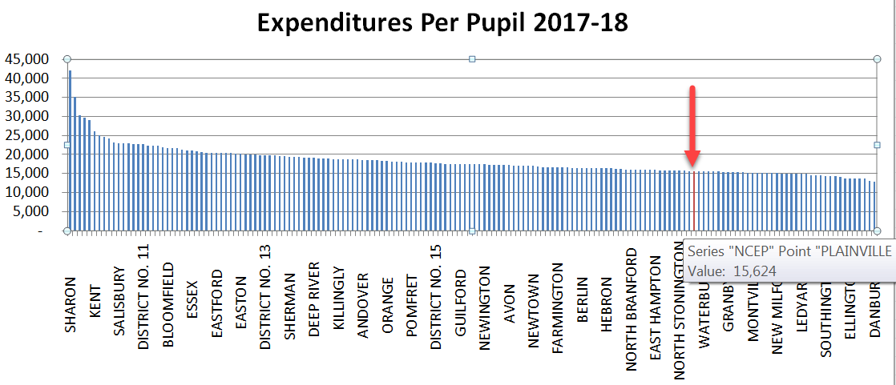
Per Pupil Cost
Plainville cost per student of $15,624 ranks #129 in cost (highest to lowest) out of 166, within the bottom quadrant of all districts.
Note: Includes all 166 districts. Every fifth name is displayed
https://3.basecamp.com/3539101/buckets/4686581/documents/1505182739
Notes:
1.2.19 Updated for 17-18
We have many successes to share this evening that have been realized even though we are 129/166 or the bottom quartile of school district spending. In other words the vast majority of school districts in our state, spend more per pupil than Plainville

Slide 31
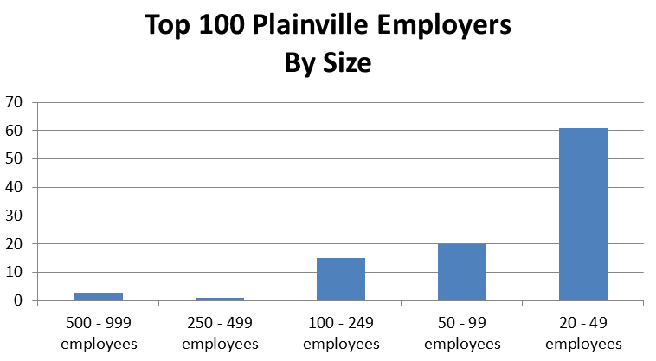
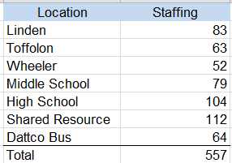
Top Employer
Along with Manafort Brothers, Wheeler Clinic and
Carling Technologies, PCS is one of the top four employers in Plainville.
Position count, payroll of 1/2/19. Includes all employees subs, coaches and the like.
https://3.basecamp.com/3539101/buckets/9134296/documents/1506854521
Notes:
1.2.19 Updated for 17-18
Includes subs, cafe … all positions worked using payroll of 1.2.19
We have many successes to share this evening that have been realized even though we are 129/166 or the bottom quartile of school district spending. In other words the vast majority of school districts in our state, spend more per pupil than Plainville

Slide 32
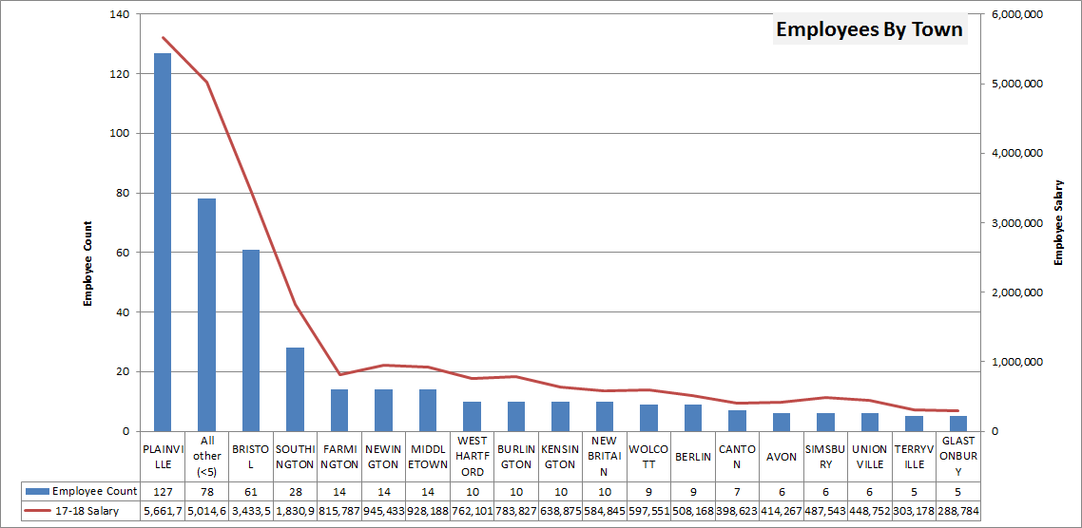
30% (127 of 429) employees in the 17-18 proposed budget live in Plainville.
An additional 32% (89 of 429) live in either Bristol or Southington.
These employees pay taxes, shop and otherwise contribute to the local economy.
Notes:
30% of our staff live in Plainville and 32% of our staff live in the towns surrounding Plainville

Slide 33
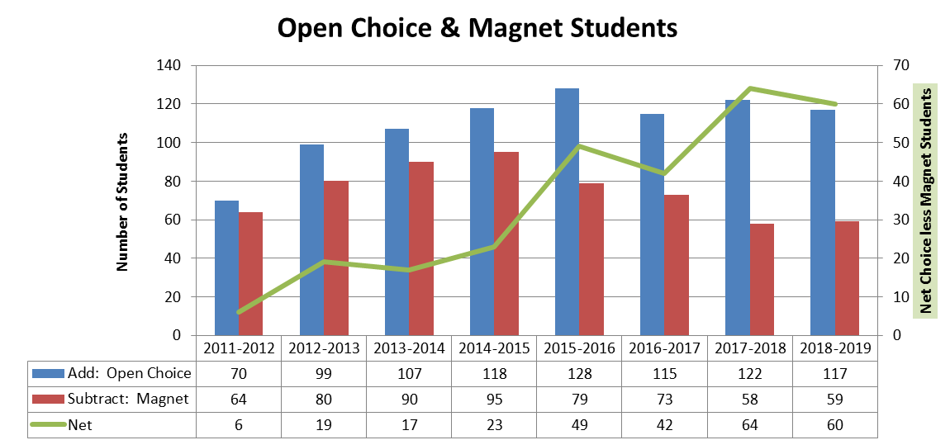
The most recent trend is a decrease in the number of students choosing magnet schools and a stable population of choice students.
Magnet School tuition currently costs the District $176,000, >$5,000 average per student.
The Choice program brings more than $1,000,000 into the District.
Presentation
https://3.basecamp.com/3539101/buckets/4339713/documents/1505522625
Notes:
Updated 1.3.19 … still want the video here?
Does not include part time Arts Academy students (3 in 18-19)
Insert PHS video here

Slide 34
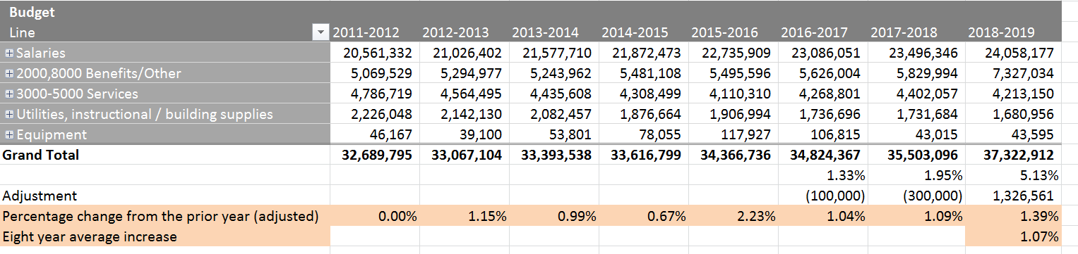
Eight Year Budget History
☛ FY 2016-2017 and FY 2017-2018 budgets were reduced $100,000 and $300,000, respectively, in reaction to State School Grant reduction (the ECS Grant)
☛ A third of the 2017-2018 budget increase was due to a 6% increase in health insurance.
☛ The 2018-19 adjustment is for health insurance, requiring a change in health insurance providers, to the Oxford State Plan from the Anthem self insurance plan
2018-19 Insurance aside & adjusting for ECS reduction, the average increase has been 1.07%, compared to an annual contractual increase of ~3.0%.
Notes:
We take a lot of pride in all we have accomplished over the last 7 years in spite of very low budget increases. This year we were approved for a 1.99% increase, but with the most recent budget cuts of $220,000 (which I will explain in a moment) this was reduced to 1.27%. Similarly, last year we were approved for 1.33% budget increase, but after a $100,000 cut, we ended up with a 1.04% increase. This makes our 7 year average increase at 1%
Source
https://3.basecamp.com/3539101/buckets/4686581/documents/783470757

Slide 35
BOE Current Budget Status
Notes:
Good Evening I am Maureen Brummett, Superintendent of Schools - I would like to thank Sam Adlerstein, Director of Business and Operations and Steve LePage, Assistant Superintendent and my entire Central Office team for their support and assistance in putting tonight’s presentation together. I appreciate the collaborative approach with the Board and Town that has been behind tonight’s presentation. Robert Lee and I will go back and forth throughout the evening
https://3.basecamp.com/3539101/buckets/1523263/google_documents/345681777

Slide 36
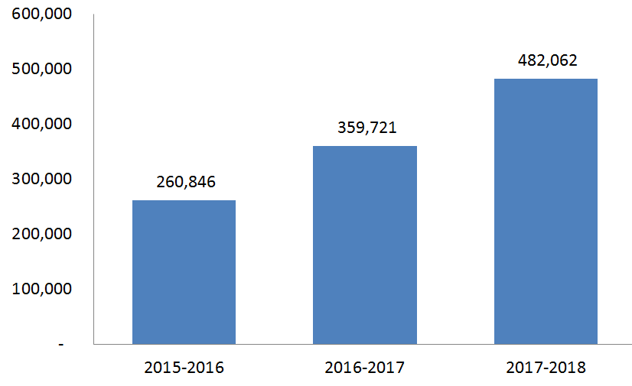
Budget Soft Freeze in 2018-19
Special Education students kept in district
  Higher Paraprofessional costs
Substitute teacher cost
Impact of facilities / maintenance freeze in 2017-18
$400,000 reduced from budget freezes over the last two fiscal years, combined
A “Soft Freeze” means:
Open Purchase Orders to be additionally reviewed.
Additional approval process for any new spending.
Teacher substitute cost, three year history →
Notes:
Sub cost source .. consider adding additional / different details
https://3.basecamp.com/3539101/buckets/9134296/documents/1501708965

Slide 37
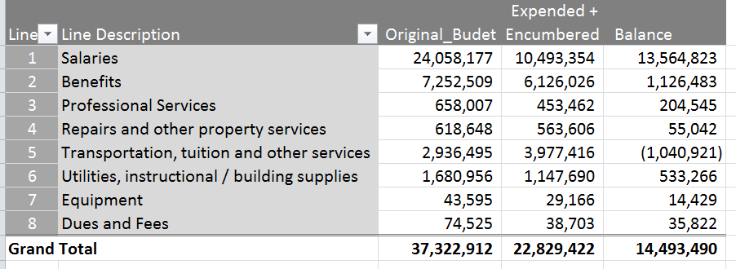
BOE Budget as of December 31, 2018
We are currently in a budget freeze in order to remain on budget by the end of the fiscal year
Line 2 includes the full year of health insurance expenditures
Fiscal years 2016-17 and 2017-18 also required budget freezes in order to cover $100,000 and $300,000 of the reduction to the State School (ESC) Grant.
  We do not forecast an ECS reduction in 2018-19, however, two years of postponing expenses and underlying activities are taking their toll.
Line 5 includes Special Education Tuition, to be partly offset by the Excess Cost Grant and other billings later in the year. This is the most difficult account to forecast, and we may need to reduce in other accounts to cover an end of year unfavorable variance.
Notes:
1.4.19 Note: difference from last year’s december balance is largely in insurance… we already recorded the full year where last year we did quarter by quarter
Currently, we are in a hard budget freeze and as a result, expenditures are looking solid at this time. As previously discussed, we plan to end the year with a balance of $220,000 that will be returned to the Town. Prior to the budget freeze the following system improvements were made that benefit both the Town and the Schools.

Slide 38
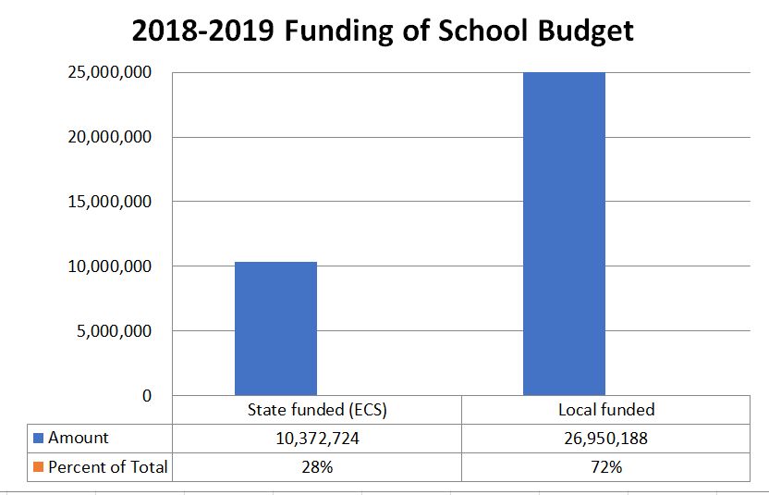
With the exception of 2018, the local school budget has been ~ 30% funded by the State, through the Education Cost Sharing (ECS) Grant. The amount of funding is based on level of need.
128 of 169 Districts received a lesser percentage than Plainville.
Notes:
Source
https://3.basecamp.com/3539101/buckets/9134296/documents/1343612553#__recording_1517303298
Past few years:
https://3.basecamp.com/3539101/buckets/9134296/documents/1343612511

Slide 39
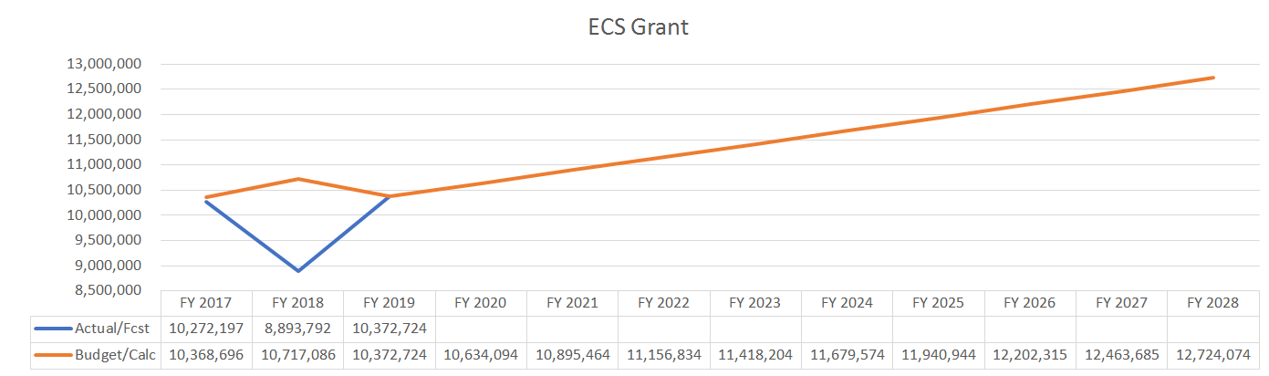
+260,000
Based on passed legislation, FY 2018 was impacted one year, off-formula plus rescission
Distribution of funding: Plainville increases under the new formula
  Fully funding is 12,724,074 based on current assumptions, phased in
Conclusion: Plainville benefits to the extent the formula is used
  The benefit (or impact) does not directly come to the school district
Notes:
Sam
Graph is in key figures and from ecs phase in schedule
https://3.basecamp.com/3539101/buckets/9134296/google_documents/1343612421

Slide 40
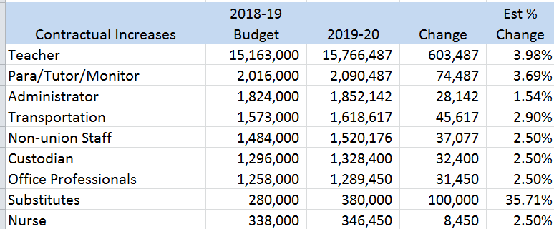
Contractual Increase from 2018-19 to 2019-20
Teacher contract is still to be negotiated as the contract was extended by one year as part of our agreement to change insurance programs. We expect the somewhat higher one-year increase to be offset in 20-21 and 21-22 contract years for a competitively negotiated three year agreement.
Notes:
Maureen
Subs
https://3.basecamp.com/3539101/buckets/9134296/documents/1501708965
Chart
https://3.basecamp.com/3539101/buckets/9134296/documents/1407465285

Slide 41
VISION
To inspire and prepare lifelong learners to follow their passion, engage in their communities, and positively impact our global society
GOALS:
STUDENTS
TEACHING
LEARNING
Develop a student centered curriculum with an emphasis on the mastery of power standards and essential skills that ensure students are college and career ready upon graduation.
Provide teachers with regular collaboration time, relevant professional development, and meaningful feedback to promote innovative teaching practices.
Ensure that systems for assessing and measuring learning targets provide data to improve teaching practices and student learning.
ACTIONS:
-Embed global competencies
-Support positive school climate/PBIS
-Implement Capstone experience
-Enrich STEAM / Makerspace opportunities
-Maximize technology resources and
supports
-Continue Instructional Rounds
-Expand student access to curriculum through
multiple pathways
-Support the continuous improvement of
Professional Learning Communities
-Develop alternative programs
-Provide engaging digital resources
for learning
-Align curriculum to CT Core and
Next Gen. Science Standards
-Audit assessments to ensure they
inform instructional practices
OUTCOMES:
Expanded high quality preschool
Increased parent/family engagement
Enhanced community collaboration
Authentic, innovative, and creative curricular experiences
College and career proficiency
Flexible teacher evaluation plan
Professional development aligned to district vision and goals
Meaningful technology integration
Increased teacher collaboration time
Culturally responsive teaching practices
Teacher recognition for innovative practices
Learning targets aligned with college/career standards and global competencies
Teachers utilize assessment data to determine student learning needs in all curricular areas
Standards based grading practices
District wide curriculum writing academy is established
2017-2018
Notes:
Our vision is at the heart of all that we do. I would like to take a few minutes to discuss our vision in action this year.

Slide 42
Vision in Action
Notes:
Good Evening I am Maureen Brummett, Superintendent of Schools - I would like to thank Sam Adlerstein, Director of Business and Operations and Steve LePage, Assistant Superintendent and my entire Central Office team for their support and assistance in putting tonight’s presentation together. I appreciate the collaborative approach with the Board and Town that has been behind tonight’s presentation. Robert Lee and I will go back and forth throughout the evening
https://3.basecamp.com/3539101/buckets/1523263/google_documents/345681777

Slide 43
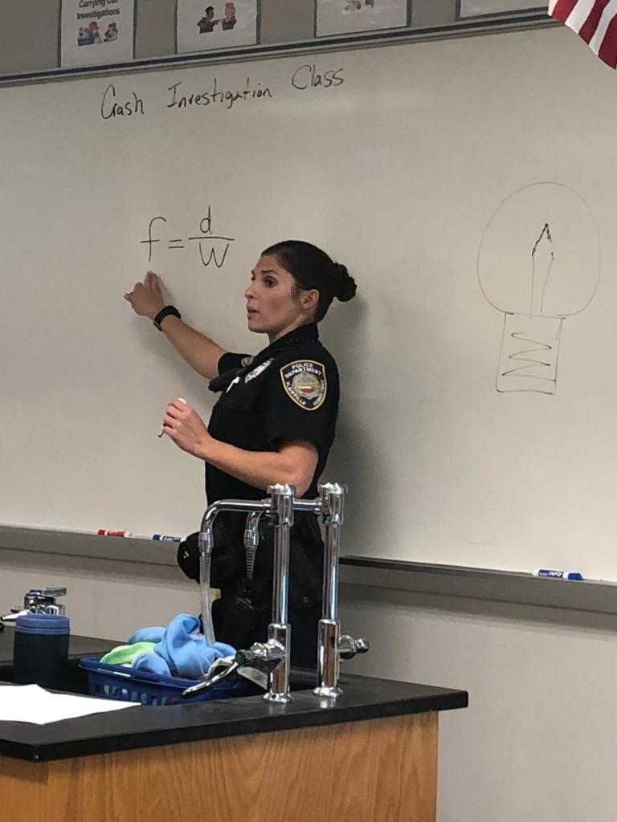
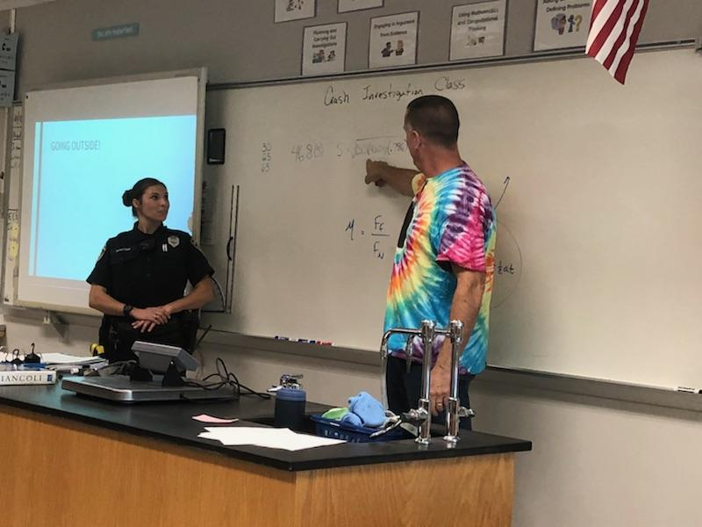
Shared Services Efficiencies...Making a Positive Impact and Saving Money
Finance
  Leveraged pension between all plans
SRO:Exceeding Expectations
  Student relationships (mediations)
  Instructing in many areas (Forensics,Physics)
  In-school investigations (ex. Social media)
Technology
  Included phone systems, infrastructure, potential for copier leases and the like
HR & Payroll
  Reorganized in 2018-19
Notes:
Redid phone systems and towns for less than $70,000, ongoing savings-$1000/month in phone bills

Slide 44

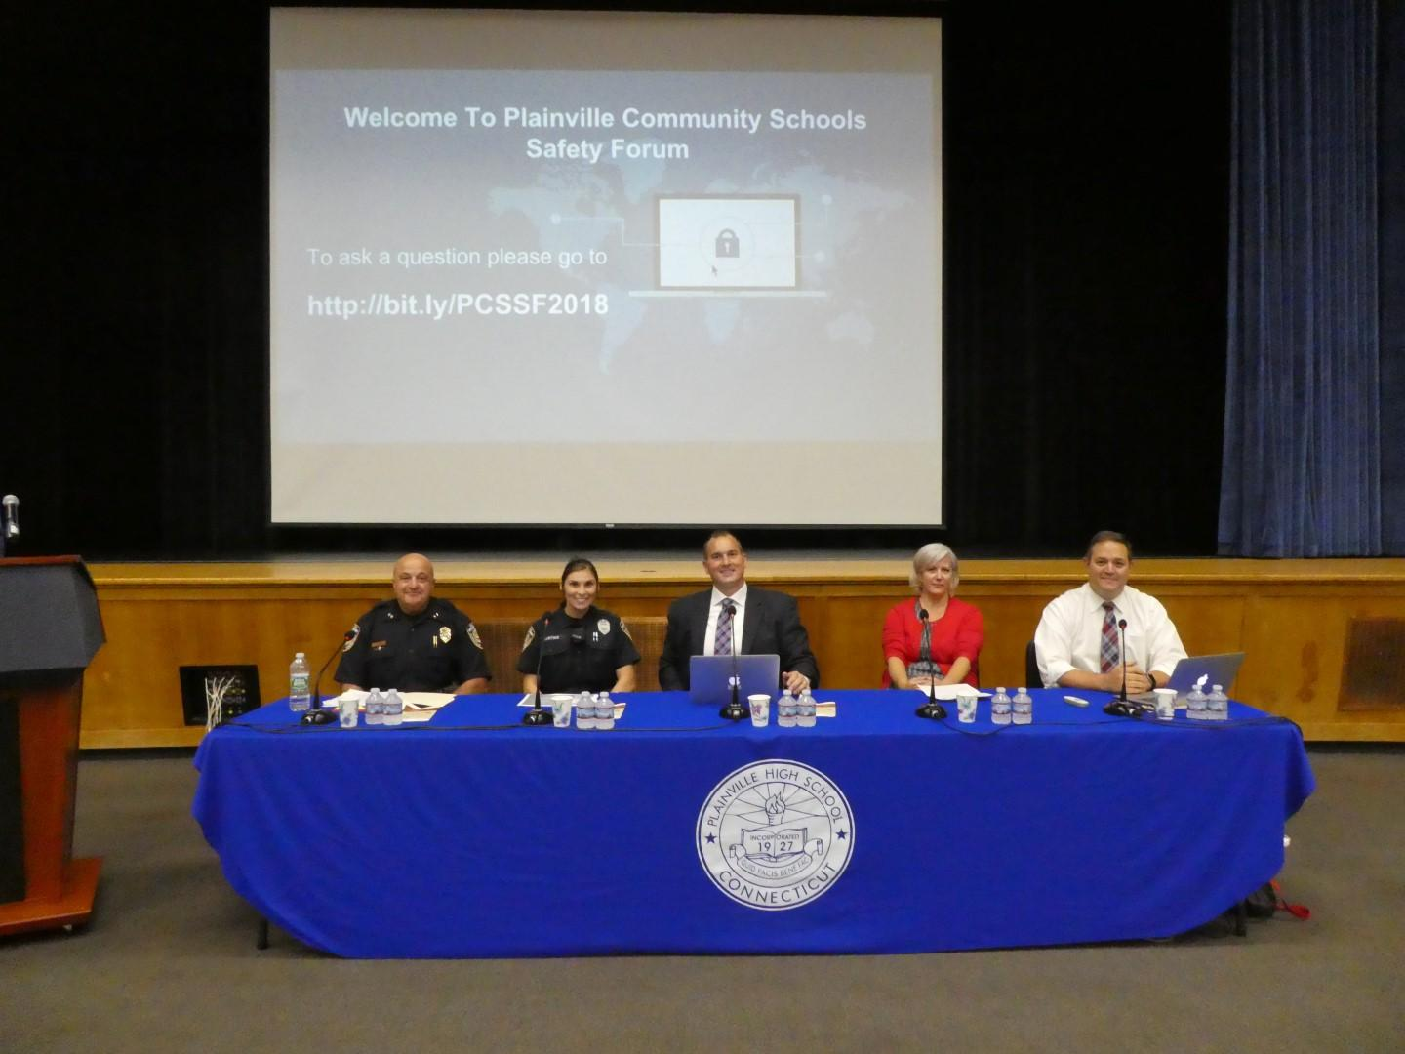
School Climate, Safety and Security
Social and Emotional Well-Being: Yale RULER Program, Mindfulness, Growth Mindset, ADL Ally Training, Culturally Responsive Education
Security Upgrades: Security Planning and Training, ALICE, Installation of Secure Entryways, New Camera Systems, 2-Way Radios, Staff and Communication Communication Systems and more
NaviGate Prepared Safety & Security: Provides an enhanced system for creating, monitoring, and implementing district safety procedures, taking attendance during drills and incidents, and communicating to families and much more.
Safety Forum: Held in September at PHS, Plainville Police-School Relationships, SRO Martins, District Climate and Anti-bullying Efforts, Mental Health Supports and Internet Safety Program
Notes:
Steve/Maureen

Slide 45

Plainville Schools:
An investment in our students’ future and in our community
STUDENTS
“We are empowering our students to succeed
in the performing and fine arts. The
performing and fine arts are an integral part of
every students’ learning, and our
administrators support the arts at all levels of
PCS.”
“For a small district, we provide our students
with a well rounded quality education. A good
education will help our students compete in
the work place and/or at the collegiate level.”
“In my opinion, Plainville schools are doing
extremely well at identifying and meeting
each individual students learning style,
strengths, and needs. This is crucial because
each student can have the opportunity to have
their needs addressed separately instead of in
a whole group setting.”
Notes:
This year we are very proud of our Pre K programs
Our new STEAM lab at the middle school is….. And was completely funded by an endowment
The PHS Alternative Learning Center will help students who are not on track to graduate on time by providing personalized educational services. The program will have a job coach, which is completely grant funded

Slide 46
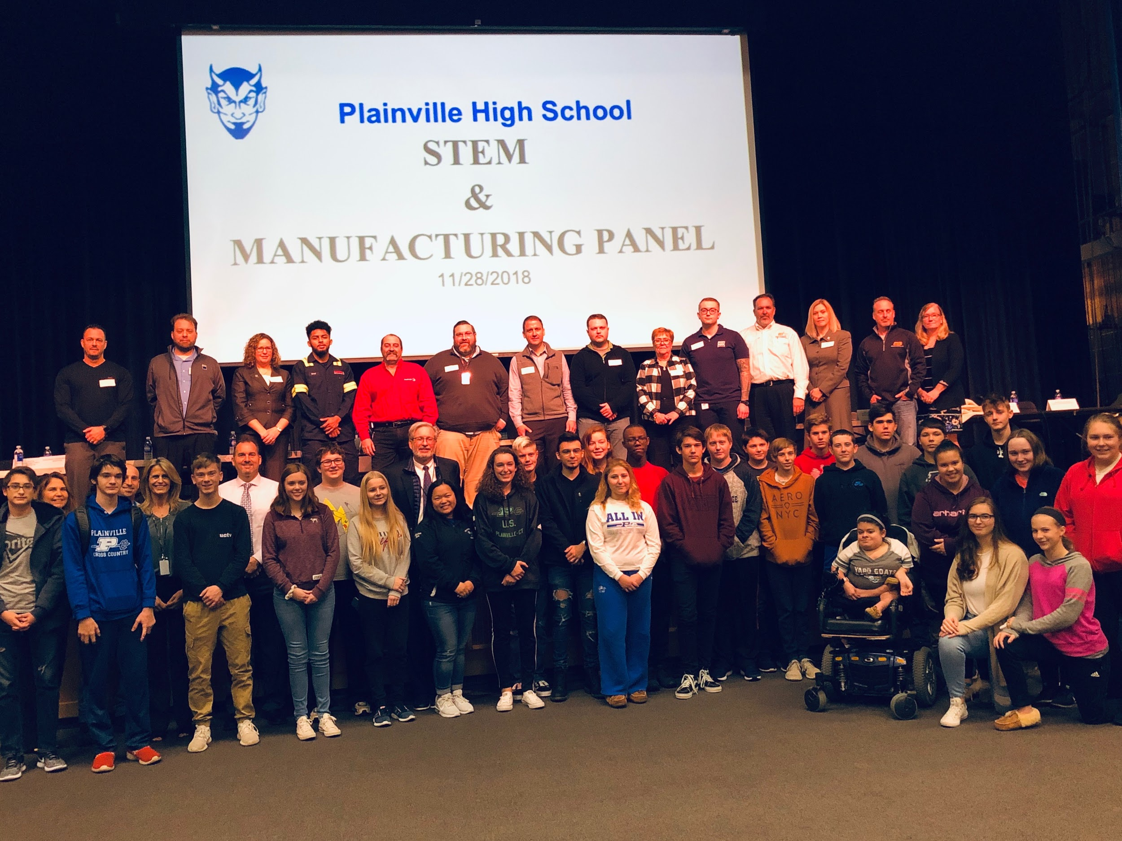
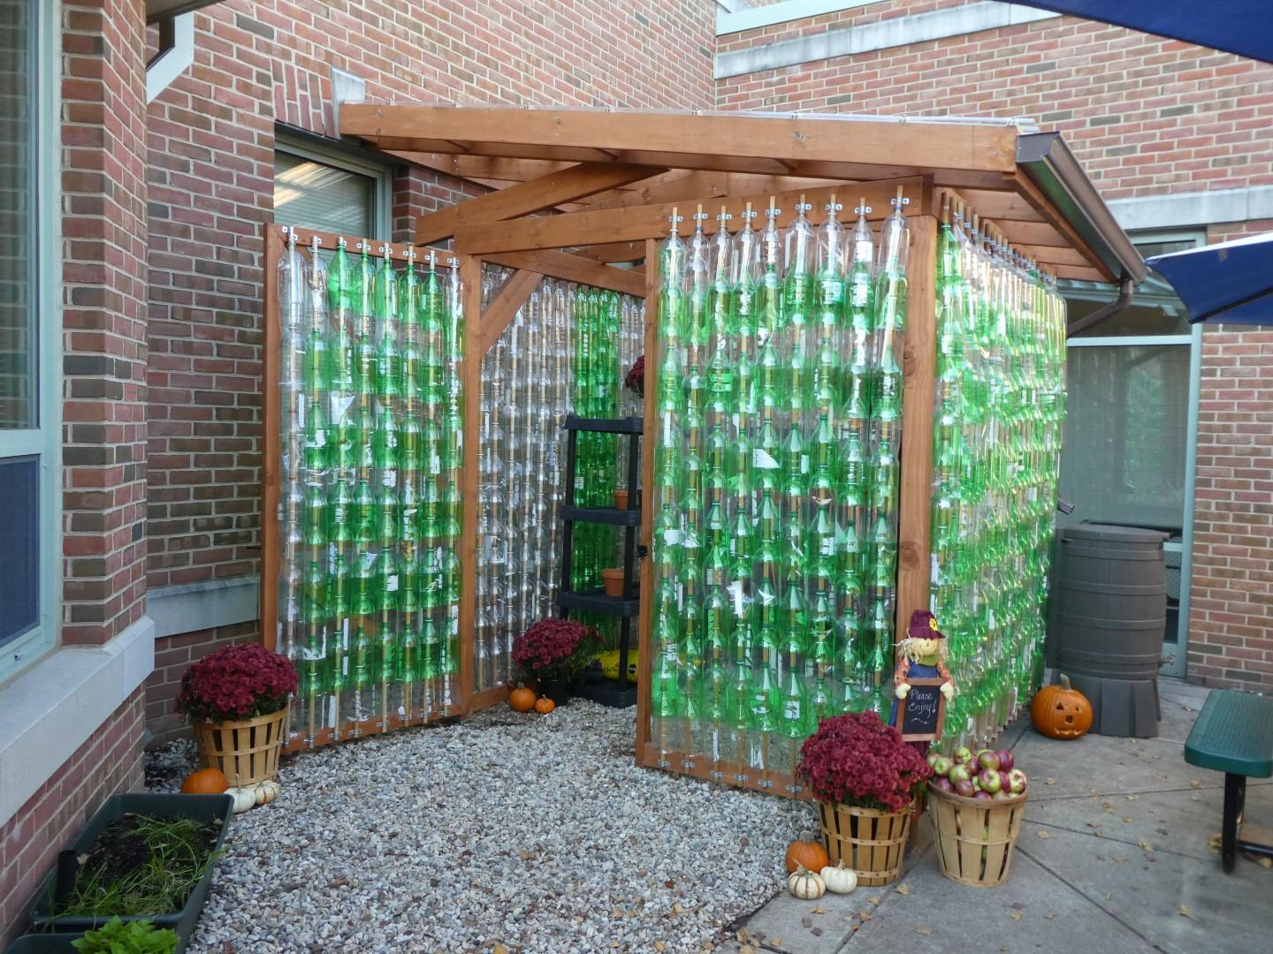
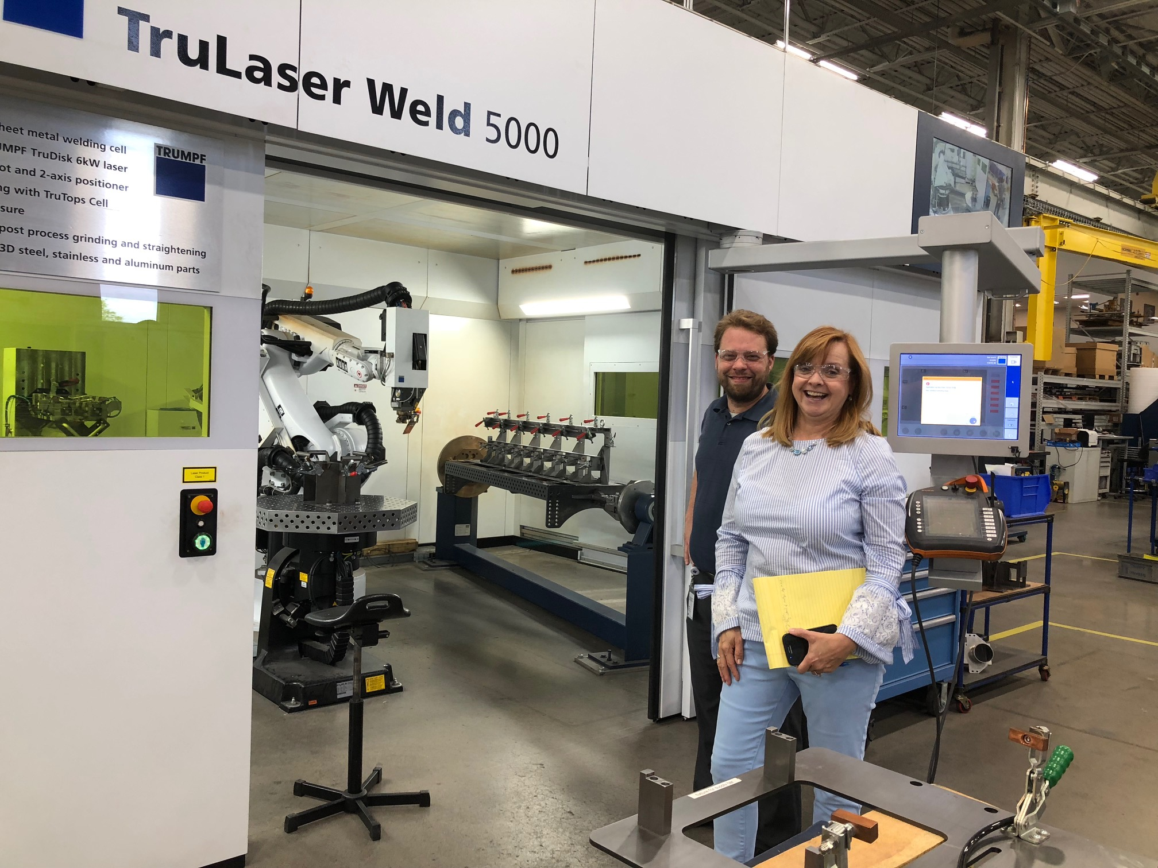
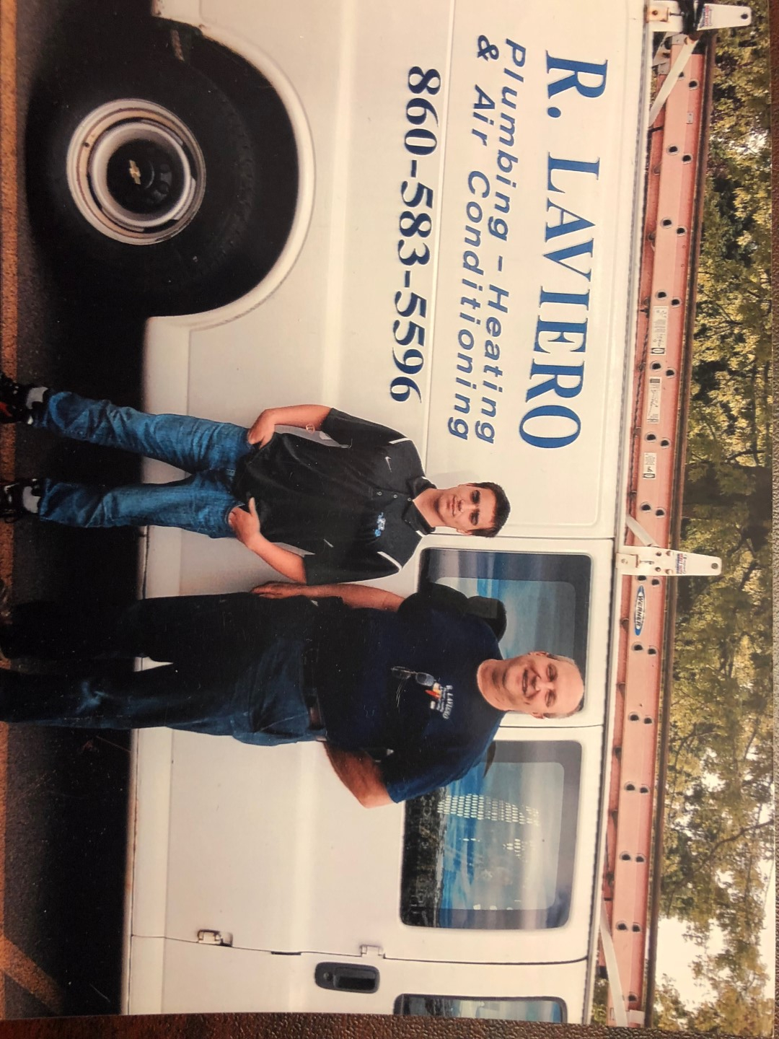
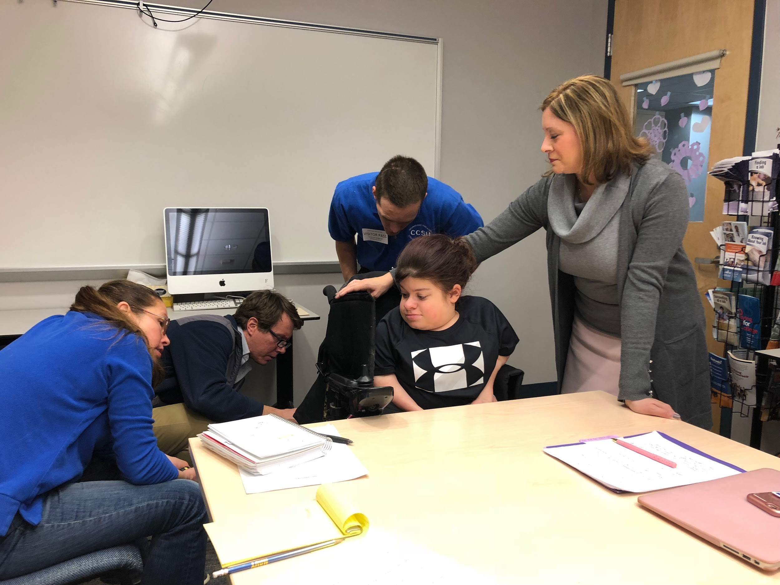
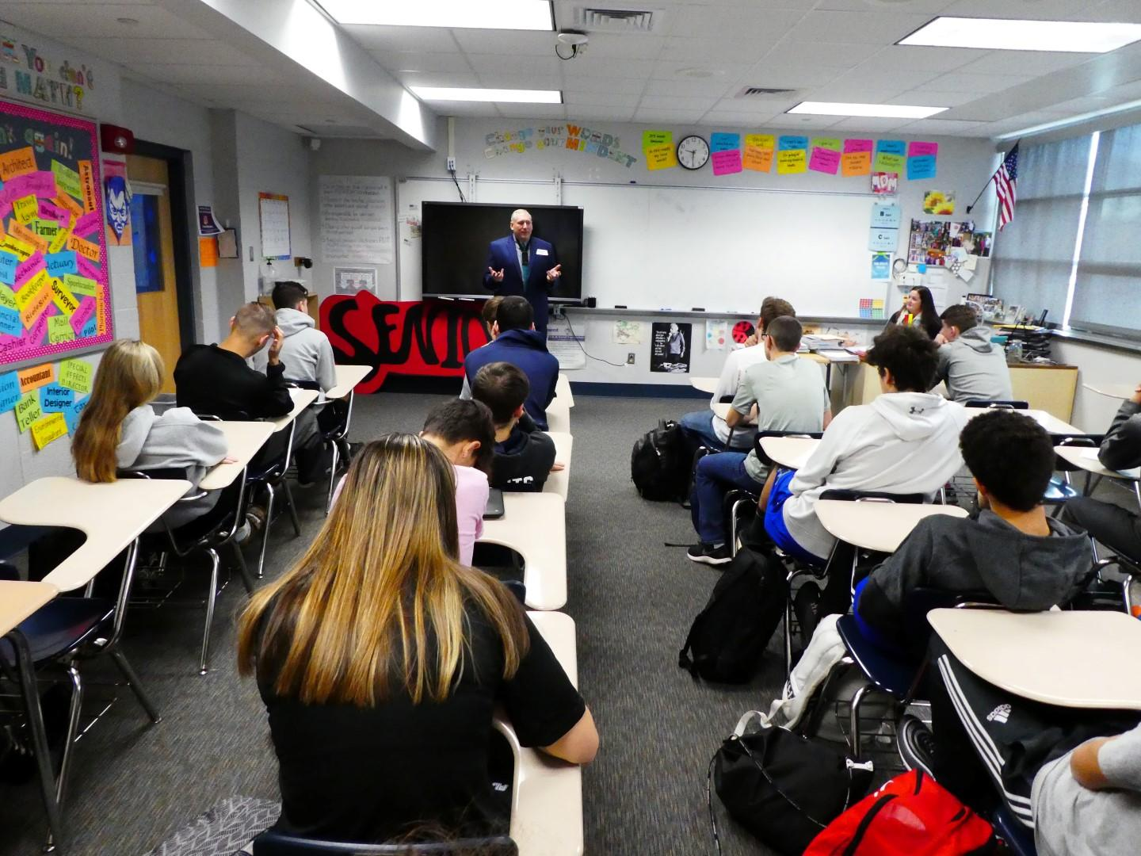
Plainville Schools:
An investment in our students’ future and in our community
STUDENTS
Expanded School / Business / Community partnerships leverage resources, support and opportunities for:
Collaborative Projects
Enhanced partnerships with local manufacturers & businesses
STEM & Manufacturing Panel
Internships, Apprenticeships &
Job Shadows
Career Day
Go Baby Go & Go Kid Go!
Notes:
Lynn and Steve

Slide 47

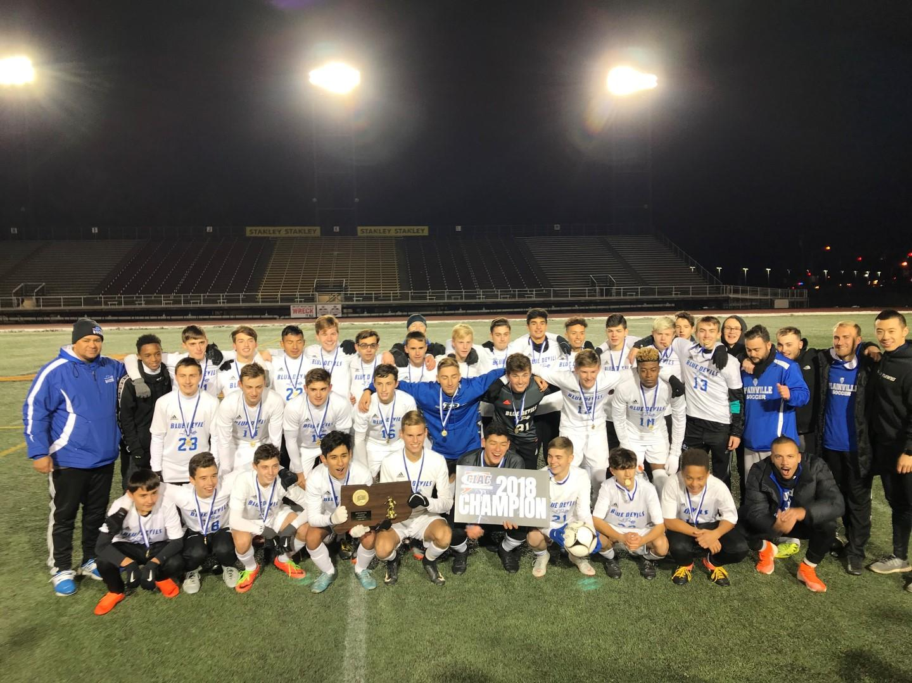
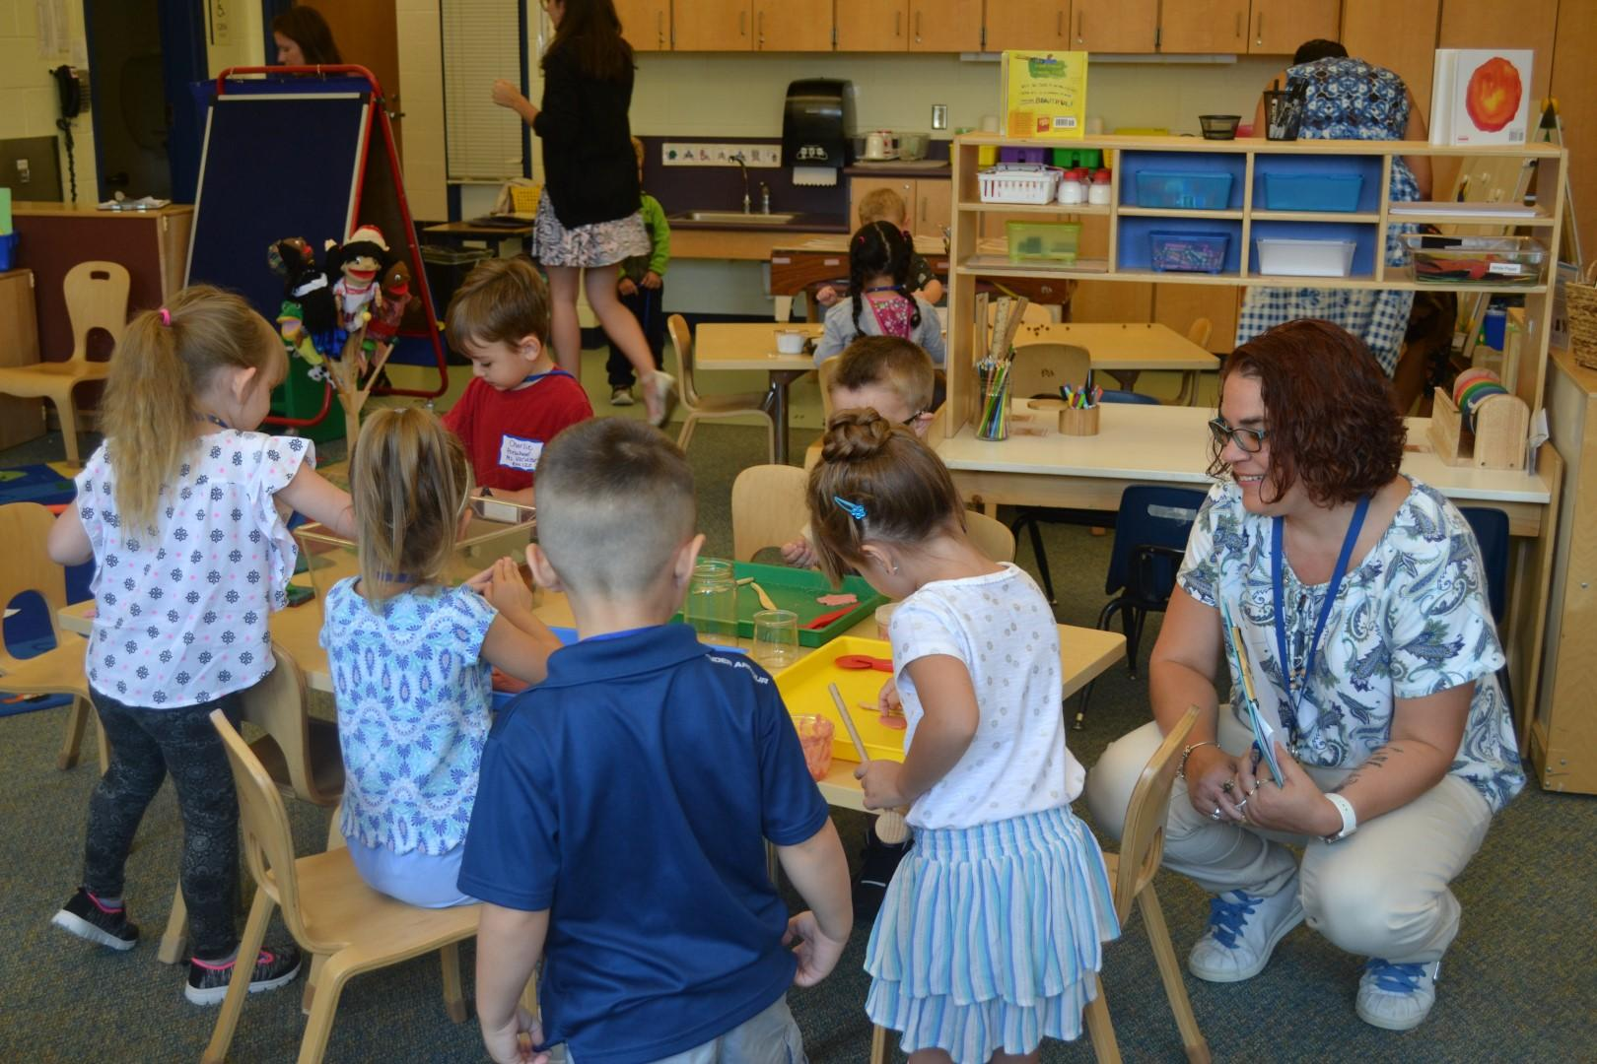
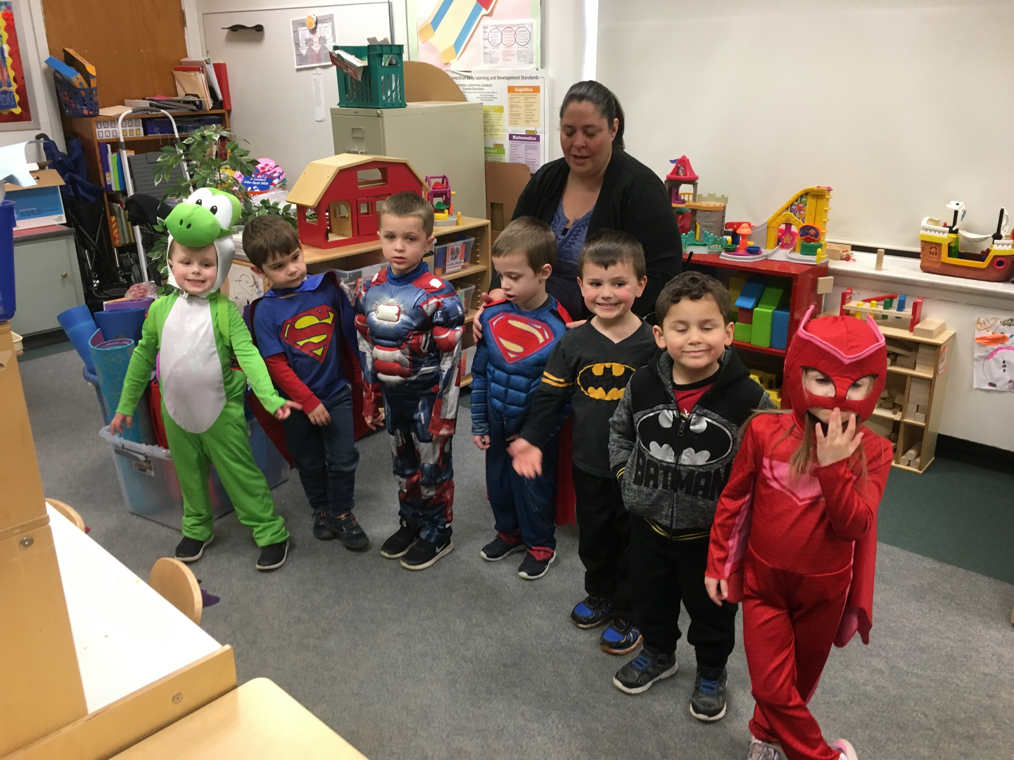
Plainville Schools:
An investment in our students’ future and in our community
STUDENTS
Pre-K programs earned high scores, now fully accredited through NAEYC
Successful NEASC process underway at PHS; 2-day visit completed
Test scores on the rise
State Champion Boys’ Soccer Team- GO BLUE DEVILS!
Notes:
Lynn and Steve
NAEYC Accreditation - This year Plainville Preschool has achieved NAEYC accreditation which represents the gold standard in certification.
Programs who achieve this honor have proven they demonstrated that they provide a safe and healthy environment for children and have teachers that are well trained who work with a curriculum that is appropriately challenging and developmentally sound.
Boys’ Soccer Team State Championship
SBA - this year, students’ performance on SBA has shown an increase. During the 2017-2018 SY, 63.7 % of students achieved a level of proficiency in the area of ELA, up from 56.4% during the 2016-2017 SY and 54.6% in the area of Math, up from 45.4% during that same school year.

Slide 48
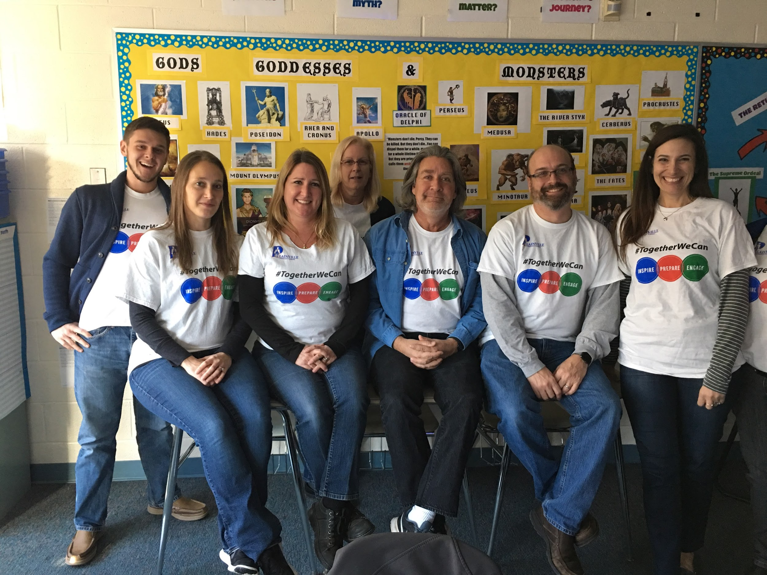
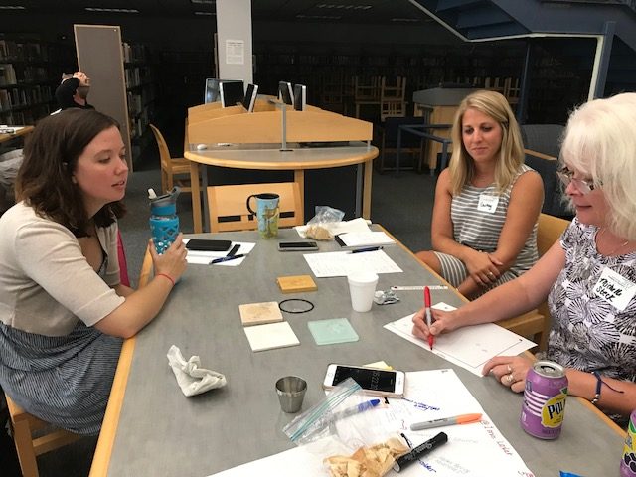
Community Thoughts...
TEACHING
“School environment and culture appears to be positive, nurturing and quite enthusiastic. It provides the setting for effective teaching and learning”
“Professionalism and collegiality are held in high regard and members of this school community work collaboratively to support student achievement”
“Collaboration among staff is a top priority”
“There are many opportunities for collaboration. Working as a team allows teachers to draw more support, learn from each other, be more effective, and share creative ideas”
Notes:
We are working hard to establishing community partnership and have renamed Lynn Davis our Director of Community Relations
Mastery Based Learning involves making student learning targets visible to students so they are more engaged in their learning
Students in Plainville complete 1000’s of hours in community service every year and are constantly fundraising to benefit important local and world wide causes
Our PLC is deeply embedded in all that we do. When teachers have time to work together during our Wed. half days they develop and refine the best teaching practices

Slide 49

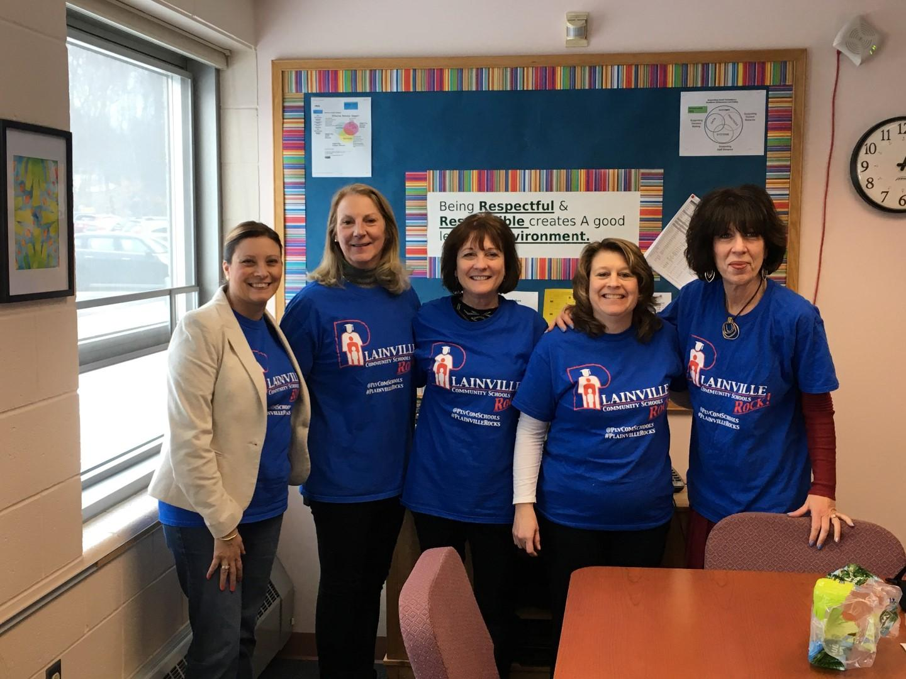
Plainville Schools:
An investment in our students’ future and in our community
TEACHING
Professional Learning Communities (PLC)
Professional Development
  Culturally Responsive Education (CRE)
  Embedded ELL Student Support Strategies
  Professional Development Days
  Science Center Partnership
Notes:
PLC - Our PLC is deeply embedded in all that we do. When teachers have time to work together during our Wed. half days they develop and refine the best teaching practices. This year, our common goal is to incorporate stage 5 practices into our learning communities. Stage 5 is characterized by engaging in calibration, examining student work, and using information used in instructional planning.
Professional Development - advancing the learning within our organizations has positive results for our students. Professional Development provides educators with the knowledge and skills necessary to meet the needs of students and extend their learning.
CRE (Culturally Responsive Education) - Our Strategic Plan invites us all to reflect upon and consider how our beliefs, practices, and decisions impact students' growth, development, and academic achievement.
PD Days -Next Gen Science Grant - Partnership with Connecticut Science Center and Southington Schools for grades 3-5 teachers to engage in high-quality professional learning lead by Science Center specialists.
Science Center Partnership -

Slide 50
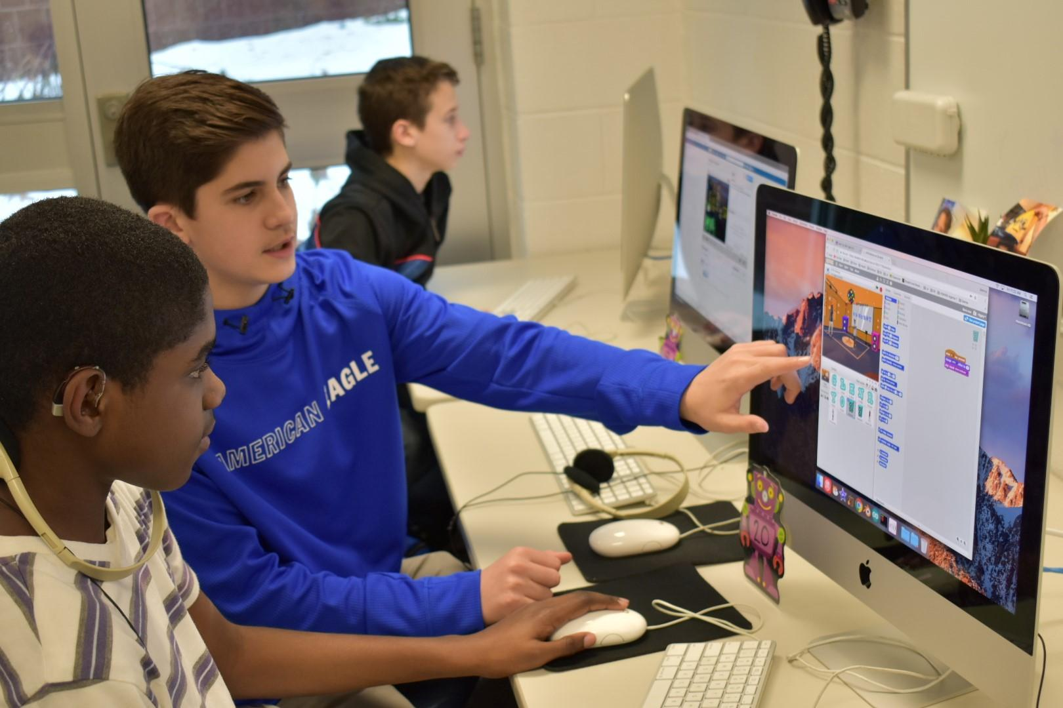
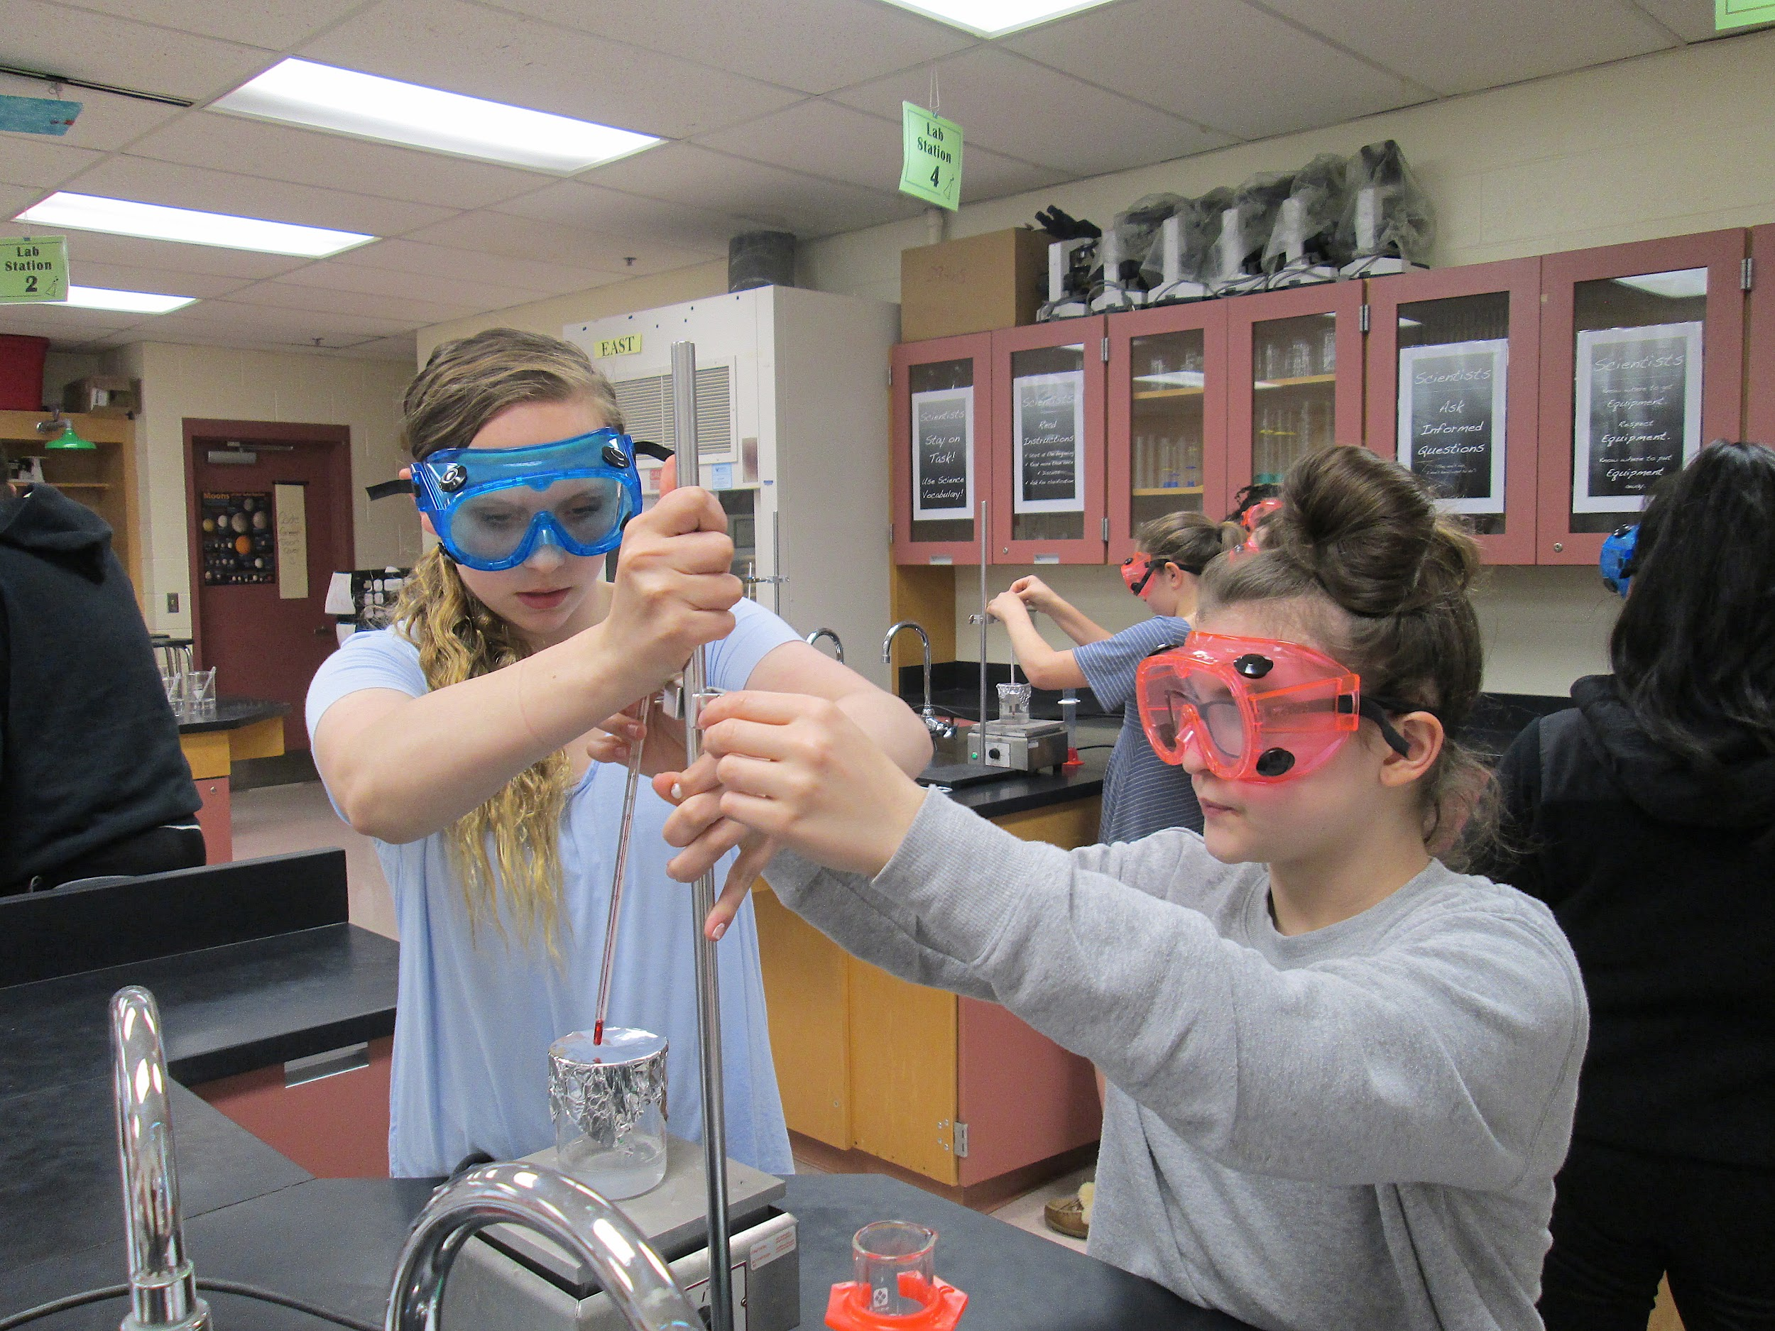
Plainville Schools:
An investment in our students’ future and in our community
LEARNING
“I think our schools are doing well preparing our students for 21st century world of work. We have invested in STEM and are consistently encouraging our students to explore and refine their interests in this area. Our students will be the workers and employers of our futures.”
“We are ahead in Technology,STEM, STEAM, and Music. We also are a leader in all day five day Pre-K.”
“I believe the school is doing well in preparing us for our future and giving us tools and skills that we need. It's important so that we succeed in the rest of the school year, in college, and in getting a job.”
“Our schools are aligning well to deliver the best academic experiences for our students as they move through the grade levels.”
Notes:
61% 4 year college, 39% 2 year
***Through our newest partnership with CCSU, PHS students have taken and succeeded at a high level, earning A’s in several courses at CCSU. Our students have multiple opportunities to earn credits while in high school, saving both time and money in their future.

Slide 51
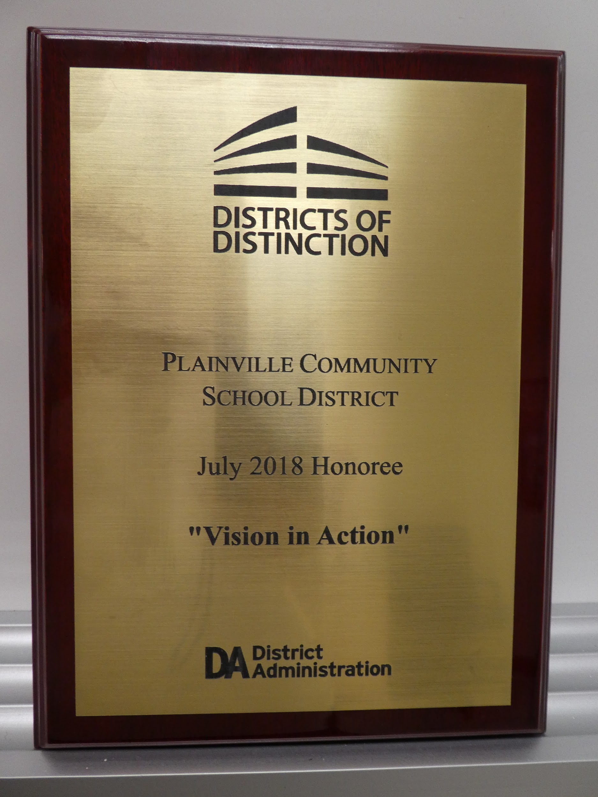
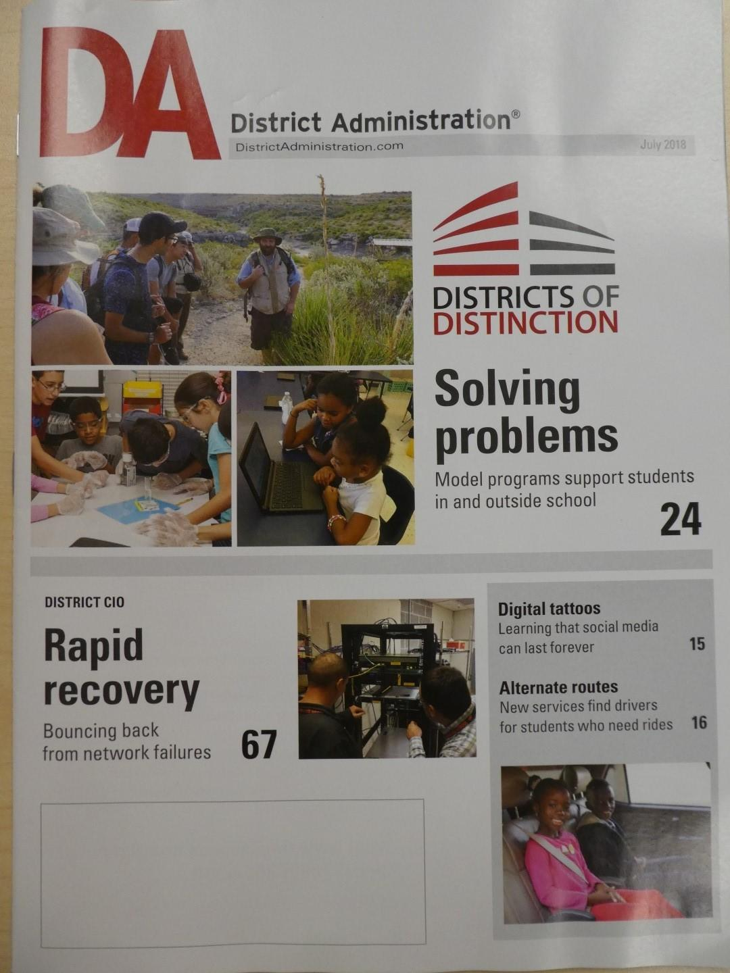
Plainville Schools:
An investment in our students’ future and in our community
LEARNING
Plainville: Leaders in Technology and Innovation:
Digital Resources for Learning: Tech Excellence Award
State Exemplar of Maker-Spaces
State-of-the-Art STEAM and STEM Labs
State, Region and National VEX Robotics Team Awards
Standards-Based Teaching, Learning and Grading Shifts:
What is Standards-Based Grading? A more accurate reporting of what students know and how they demonstrate their learning of state content standards.
Why Standards-Based Grading? More accurate communication about what each student knows and is able to do (relative to the most critical standards)
  Improves feedback, student ownership of learning, and student engagement.
  Gradual transition, with staff, parent and student feedback and input
Notes:
61% 4 year college, 39% 2 year
***Through our newest partnership with CCSU, PHS students have taken and succeeded at a high level, earning A’s in several courses at CCSU. Our students have multiple opportunities to earn credits while in high school, saving both time and money in their future.
according to content standards and separately assess the influence of positive and consistent work habits (habits of scholarship) on student learning.

Slide 52
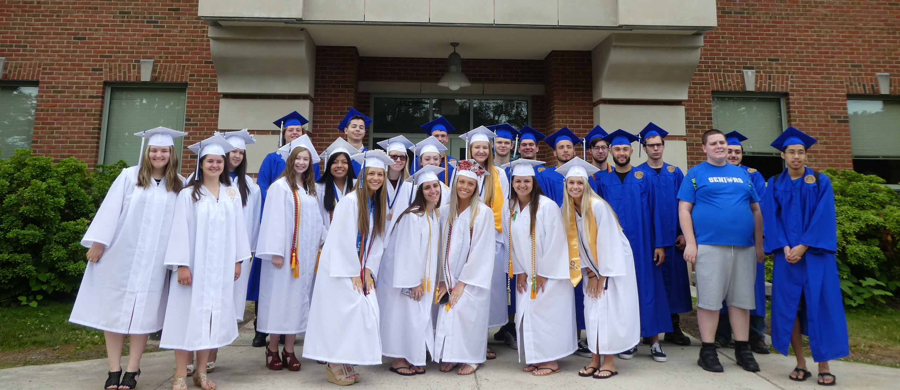
Plainville Schools:
An investment in our students’ future and in our community
LEARNING
PLAINVILLE HIGH SCHOOL CLASS OF 2018
78% of our students are pursuing higher education
98% of our students left high school with a clear post- secondary plan
72% were accepted into their first choice college or trade preparation program
5,330 hours of community service
1,004 ECE college credits = $1.1 million in savings!
15% of PHS students took one or more Advanced Placement course
$200,385 in local scholarships received
Notes:
61% 4 year college, 39% 2 year
***Through our newest partnership with CCSU, PHS students have taken and succeeded at a high level, earning A’s in several courses at CCSU. Our students have multiple opportunities to earn credits while in high school, saving both time and money in their future.

Slide 53
Town Current Budget Status
Notes:
Good Evening I am Maureen Brummett, Superintendent of Schools - I would like to thank Sam Adlerstein, Director of Business and Operations and Steve LePage, Assistant Superintendent and my entire Central Office team for their support and assistance in putting tonight’s presentation together. I appreciate the collaborative approach with the Board and Town that has been behind tonight’s presentation. Robert Lee and I will go back and forth throughout the evening
https://3.basecamp.com/3539101/buckets/1523263/google_documents/345681777

Slide 54
Town: Current Budget Status

Slide 55
State Budget Outlook
  $242 Million Surplus – Current FY
  Projected Deficit
    FY 20 (OFA) - $1.9 Billion
    FY 21 (OFA) - $2.5 Billion
    FY 22 (OFA) - $2.7 Billion
    FY 23 (OFA) - $4.0 Billion
  The Governor’s Purposed Budget will be released on Wednesday, February 6th.
Notes:
Robert

Slide 56
Expenditures: Through Nov. 2018
 |  |  | FY 2019 |  | Spent thru |  | Est thru
Budget Category |  |  | Budget |  | 11/30/2018 |  | 6/30/2019 |  | Variance
Expenditures
General Government |  |  | 2,506,769 |  | 1,295,261 |  | 2,450,000 |  | 56,769
Public Safety |  |  | 4,698,220 |  | 1,795,834 |  | 4,700,000 |  | (1,780)
Public Works |  |  | 4,140,078 |  | 1,772,696 |  | 4,120,078 |  | 20,000
Health & Human Services |  |  | 1,730,045 |  | 650,599 |  | 1,715,000 |  | 15,045
Civic & Cultural |  |  | 156,755 |  | 64,288 |  | 154,291 |  | 2,464
Employee Benefits |  |  | 3,509,666 |  | 2,104,686 |  | 3,509,666 |  | -
Sundry |  |  | 791,613 |  | 671,546 |  | 781,613 |  | 10,000
 |  |  | 17,533,146 |  | 8,354,910 |  | 17,430,648 |  | 102,498
Debt Service |  |  | 4,400,000 |  | 2,414,390 |  | 3,906,944 |  | 493,056
Capital |  |  | 800,000 |  | 400,000 |  | 800,000 |  | -
 |  |  | 22,733,146 |  | 11,169,300 |  | 22,137,592 |  | 595,554
Notes:
Robert

Slide 57
Revenues: Through Nov. 2018
 |  |  | FY 2019 |  | Spent thru |  | Est thru
Budget Category |  |  | Budget |  | 11/30/2018 |  | 6/30/2019 |  | Variance
Revenue
Property taxes |  |  | 47,039,457 |  | 27,095,695 |  | 47,039,457 |  | -
Licenses & permits |  |  | 281,700 |  | 181,310 |  | 435,144 |  | 153,444
Fines & fees |  |  | 271,700 |  | 95,892 |  | 230,141 |  | (41,559)
Use of Money |  |  | 30,500 |  | 32,713 |  | 78,511 |  | 48,011
Intergovernmental |  |  | 11,233,458 |  | 2,608,800 |  | 11,233,458 |  | -
Other revenues |  |  | 1,199,243 |  | 390,277 |  | 899,243 |  | (300,000)
 |  |  | 60,056,058 |  | 30,404,687 |  | 59,915,954 |  | (140,104)
debt management fund not being used
Notes:
Robert

Slide 58
Unassigned Fund Balance: Through Nov. 2018
UNAUDITED UNASSIGNED FUND BALANCE (6/30/18) |  |  |  |  | 8,302,402 | 11.75%
FY 19 use of fund balance - budgeted
 | FY19 Tax Relief (budgeted $204,000) |  |  | (204,000) | (204,000)
 | Add Approp: None to date |  |  | 0 | 0
ESTIMATED UNASSIGNED FUND BALANCE (6/30/19) |  |  |  |  | 8,098,402 | 11.56%
Notes:
Robert

Slide 59
Town Expenditure Changes (Estimate)
Town Employee Salary Increases at 2.00% | $ | 162,250
LAP and WC insurances |  | (117,625)
Health Insurance |  | 135,000
Defined Benefit Pension |  | 15,000
LAP/WC actually a decrease of $117,625. This is due to us budgeting at the CIRMA rates last year before the Council approved the move to Trident, which lowered our costs. This decrease is a budget to budget decrease with a 3% increase on what we have paid this year.
Health insurance increase is estimated at 8% at this time; more information coming in the next few weeks.
Defined benefit pension plan cost increase is estimated at $15,000 at this time.
Notes:
Robert

Slide 60
Debt Service Capacity Analysis
Notes:
Robert

Slide 61
Budget Schedule FY 2019-2020
Notes:
Good Evening I am Maureen Brummett, Superintendent of Schools - I would like to thank Sam Adlerstein, Director of Business and Operations and Steve LePage, Assistant Superintendent and my entire Central Office team for their support and assistance in putting tonight’s presentation together. I appreciate the collaborative approach with the Board and Town that has been behind tonight’s presentation. Robert Lee and I will go back and forth throughout the evening
https://3.basecamp.com/3539101/buckets/1523263/google_documents/345681777

Slide 62
Proposed FY 2020 Budget Schedule
March 4 – Town Manager’s proposed budget presented to Town Council
March 7 – Public hearing on Town Manager’s proposed budget
March 11-21 – Town Council budget work sessions (3/11-14, 3/19, 20 & 21 if needed)
April 8-10 – Public hearing on Town Council’s proposed budget
April 30 – Budget Town Meeting/all day vote (TC sets mill rate within 30 days)

Slide 63
Questions
Notes:
Good Evening I am Maureen Brummett, Superintendent of Schools - I would like to thank Sam Adlerstein, Director of Business and Operations and Steve LePage, Assistant Superintendent and my entire Central Office team for their support and assistance in putting tonight’s presentation together. I appreciate the collaborative approach with the Board and Town that has been behind tonight’s presentation. Robert Lee and I will go back and forth throughout the evening
https://3.basecamp.com/3539101/buckets/1523263/google_documents/345681777

Slide 64

Questions

